Slide 1

SUBSCRIBER’S GALORE
EXPLORING THE WORLD’S TOP YOUTUBE CHANNELS

Slide 2
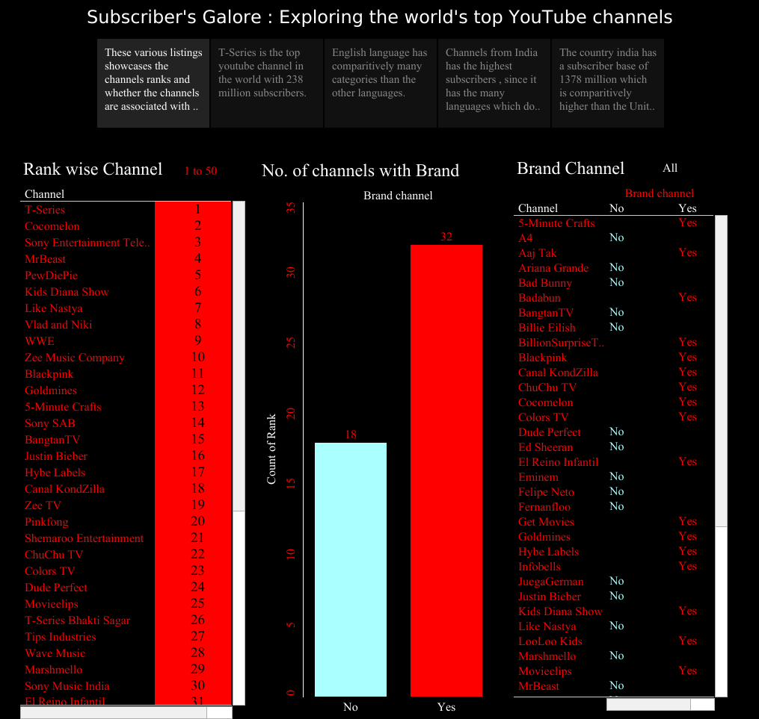

Slide 3
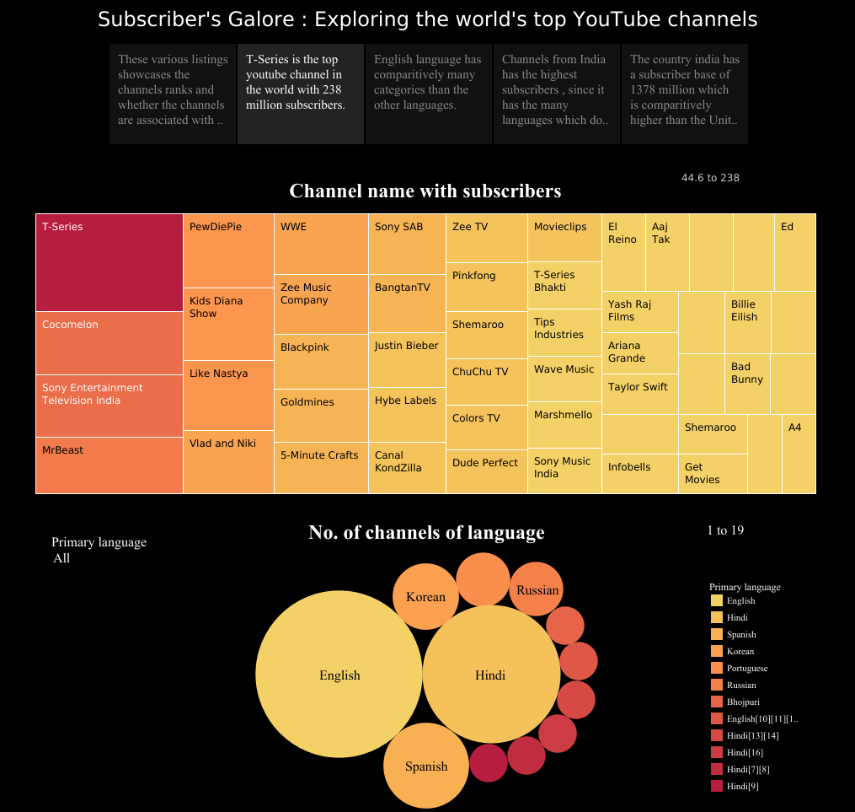

Slide 4
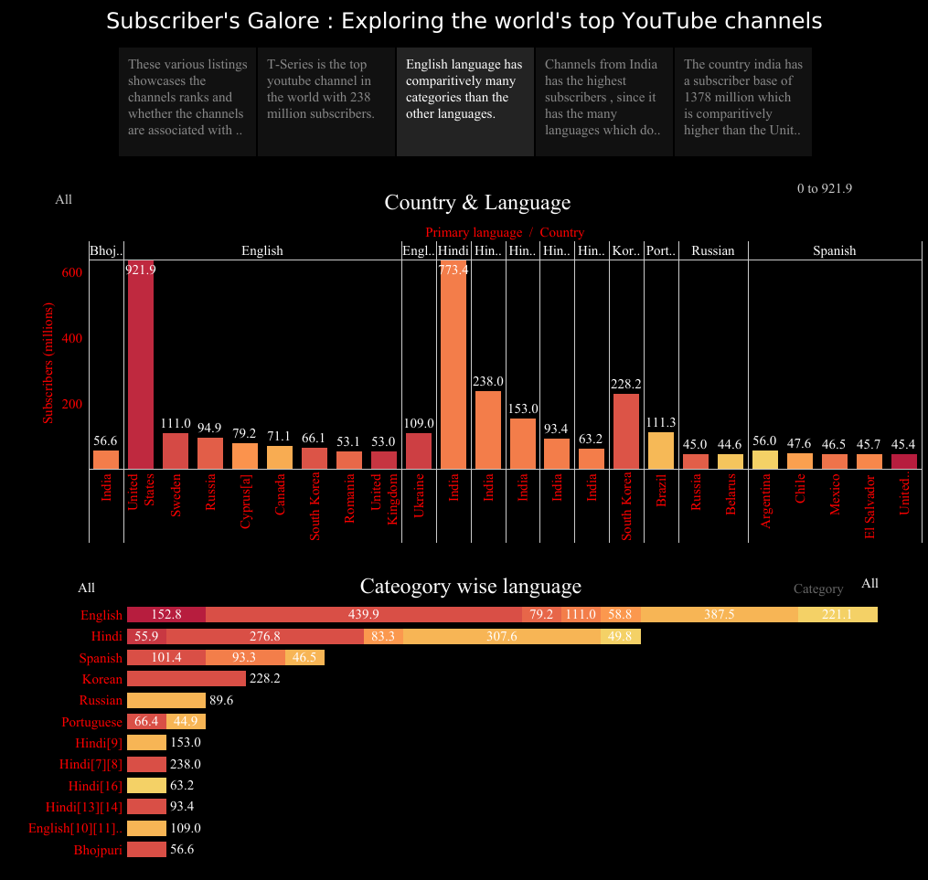

Slide 5
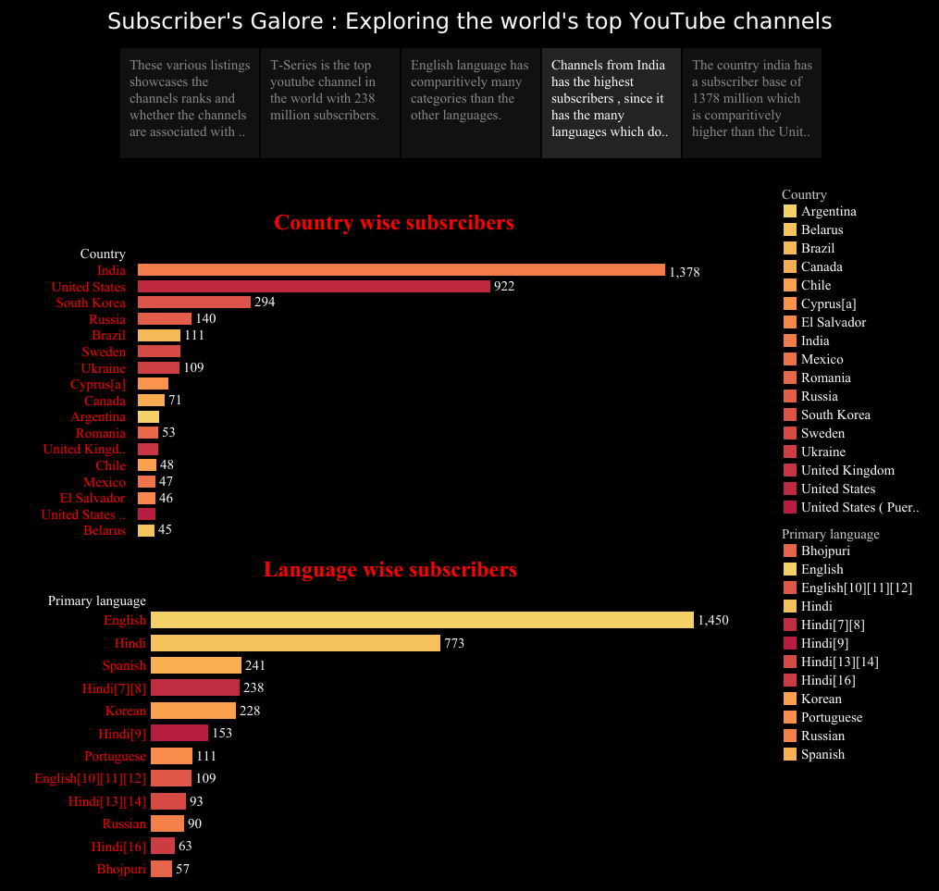

Slide 6
